Slide 1



HEART DISEASE PREDICTION
By Harsh Sindhwa

Slide 2

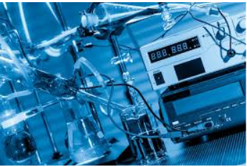
Why is the subject important?
Require expensive equipment and invasive procedures.
Difficult to identify heart disease.
Regarded as most important subject in the section of clinical data analysis.

Slide 3

Why is it important to the audience?
Heart disease is a leading cause of death (1 in 4).
Coronary Heart Disease (CHD) is the most common type of heart disease killing over 3,70,000 people annually.
Every year about 7,35,000 Americans have a heart attack.

Slide 4
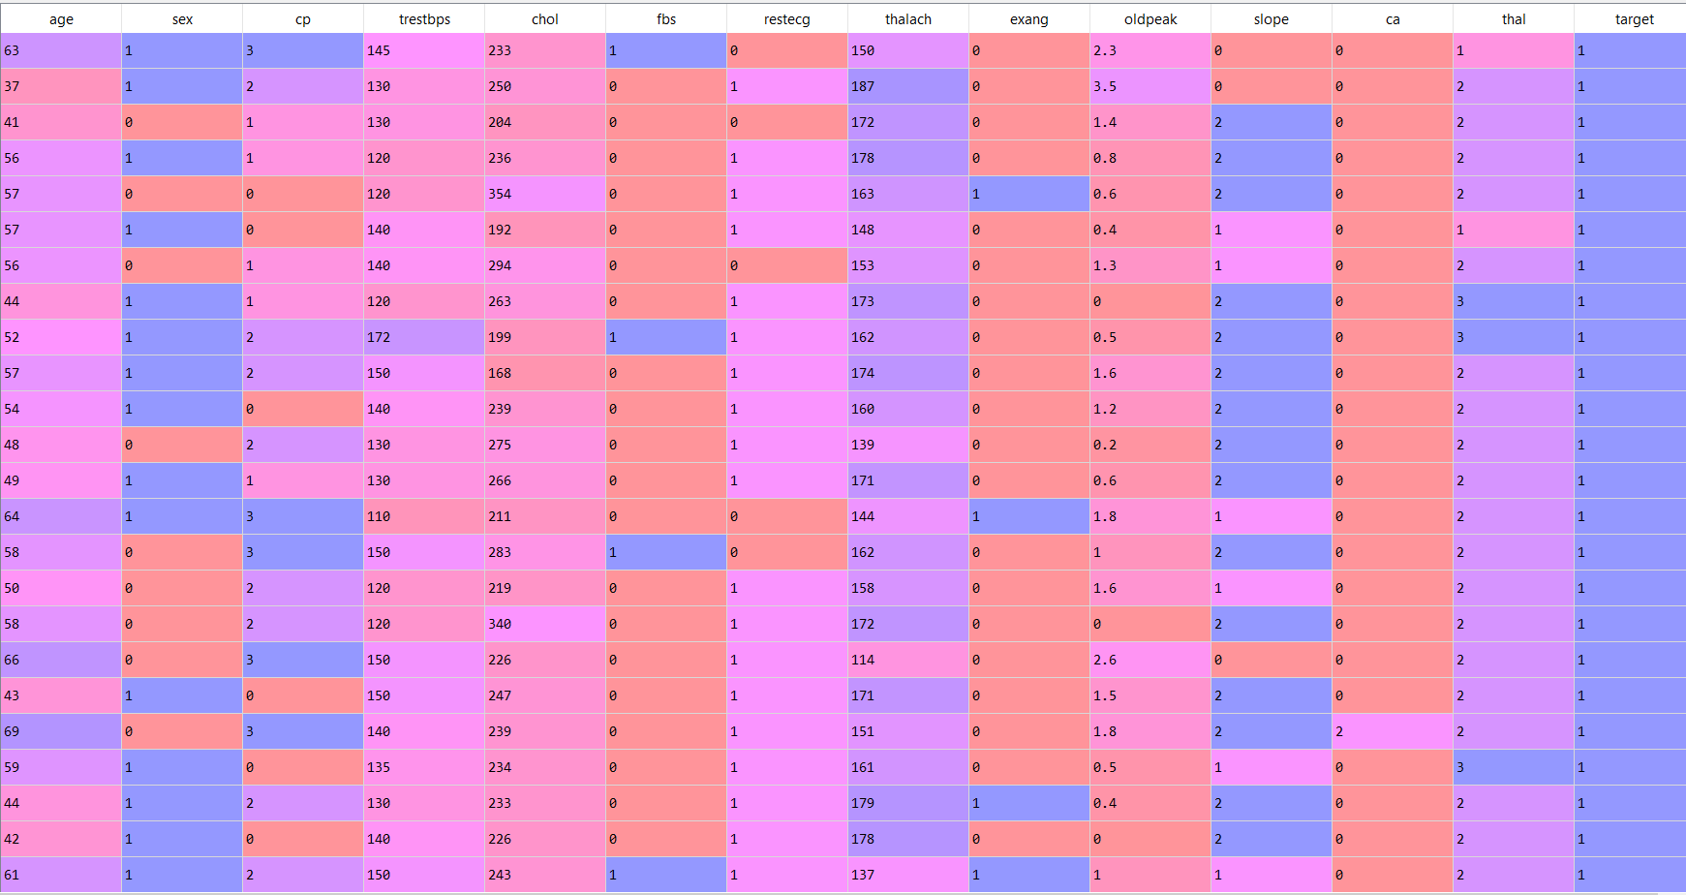

Slide 5

What I am trying to predict?
I am trying to predict whether a person has heart disease or not.

Slide 6


Slide 7

Classification Models Used
Decision Tree
Random Forest
KNN Classifier

Slide 8
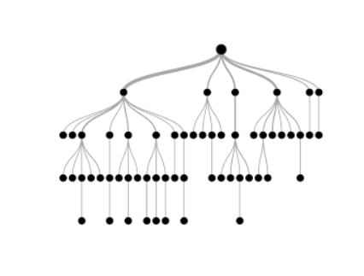
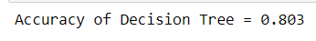
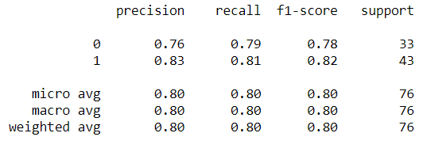
Why Decision Tree?

Slide 9
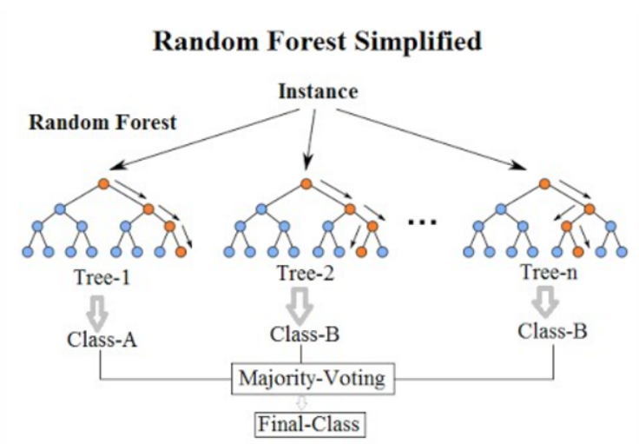
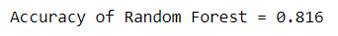
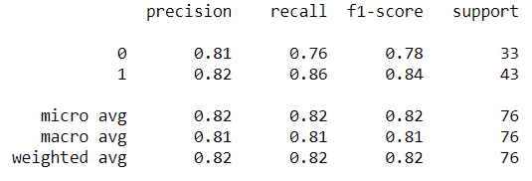
Why Random Forest?

Slide 10
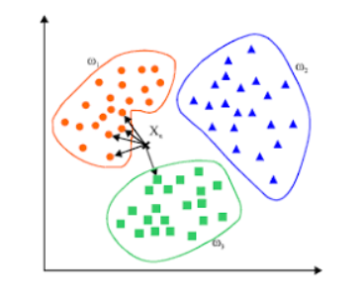
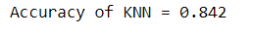
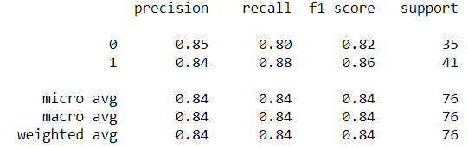
Why KNN Classifier?

Slide 11
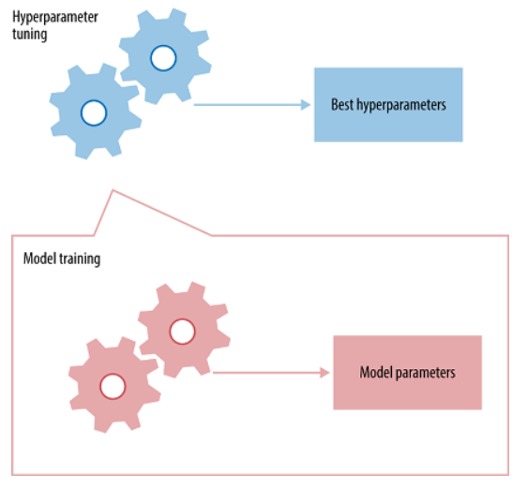
Tuning of Random Forest

Slide 12
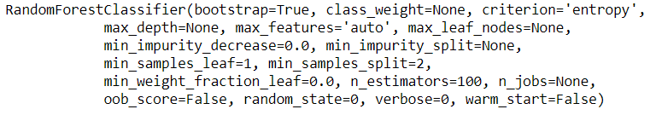
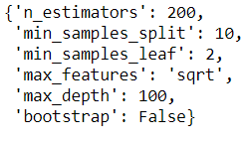
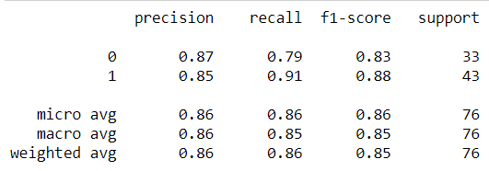
Results
obtained
after
tuning

Slide 13

What I will do 3 months from now?
Possibility of over fitting of data.
Collect more data in the age groups.
Try and improvise the accuracy.
May use ensemble classifier such as XGboost

Slide 14

What I will do in the coming 1 year?
Deploy this idea in hospitals.
Provide a UI platform based App.

Slide 15

References
Ronit. (2018, June 25). Heart Disease UCI. Retrieved from https://www.kaggle.com/ronitf/heart-disease-uci.
Singh, P., Singh, S., & Pandi-Jain, G. S. (2018, March 15). Effective heart disease prediction system using data mining techniques. Retrieved from https://www.ncbi.nlm.nih.gov/pmc/articles/PMC5863635/.

Slide 16

Thank You

